Slide 1
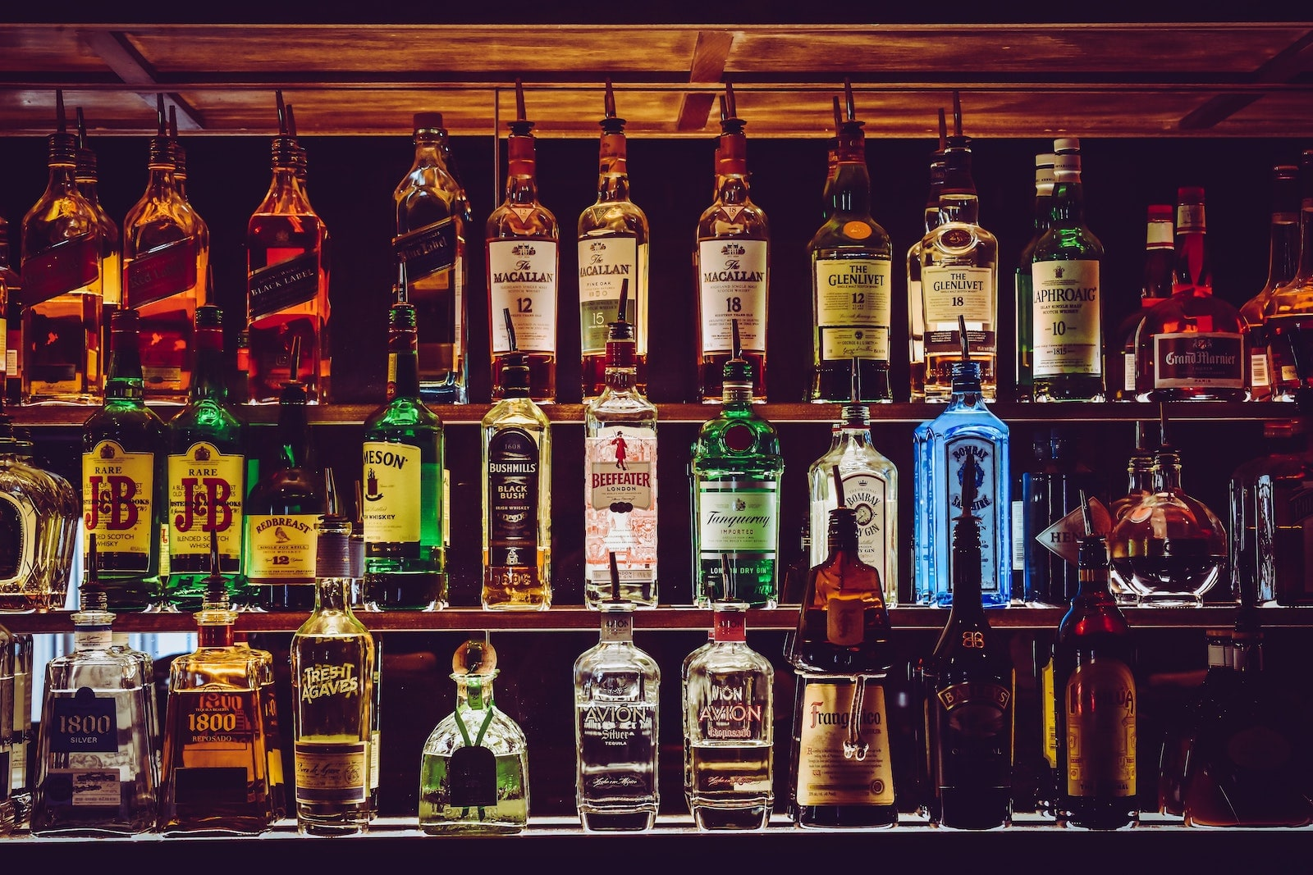
Does Alcohol cause happiness?
Tim Raynor, Amanda Belloma, Jamie Lewis, Dallas Diaz

Slide 2
What did we research?
Is there a correlation between the amount of breweries and wineries and the overall happiness scores of each state?
What other factors might have an impact on the overall score that we are looking at?
Can machine learning help us find a definite correlation?

Slide 3
Data Sources
WINERIES
Data related to the number of wineries in the United States was obtained from wine-road.com (source data attributed to The National Association of American Wineries). Data includes the number of wineries grouped by state. Link Here
BREWERIES
Data related to the number of breweries in the United States was obtained kaggle.com. Data includes brewery name, type, address, website, state, total breweries in state. Link Here
Found a more comprehensive list https://www.brewersassociation.org/directories/breweries/ & https://en.wikipedia.org/wiki/List_of_breweries_in_the_United_States
UNITED STATES HAPPINESS SCORE BY STATE ETC.
Creating a combined CSV file of a happiness score article and the wineries and breweries csvs that we had used in the previous projects. https://wallethub.com/edu/happiest-states/6959/

Slide 4
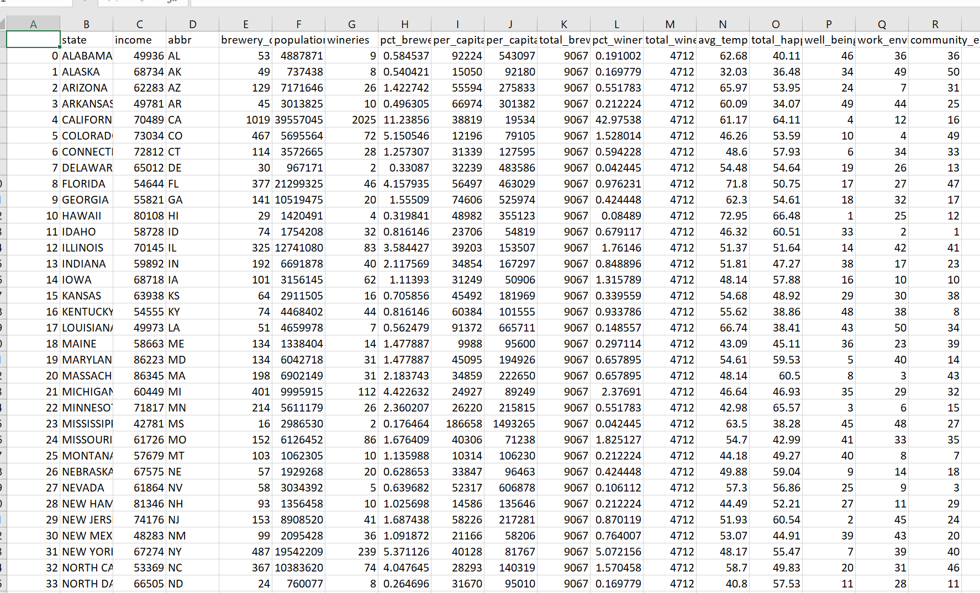

Getting our Data
Created a combined CSV of previous used csv files from Project 2.
Dropped unused data
Renamed columns
Searched data frames to validate data could be pulled

Slide 5
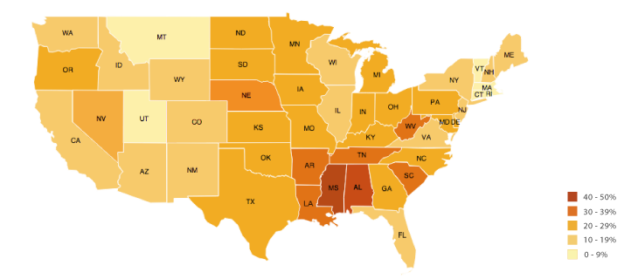
Coding and Tools
JAVASCRIPT
JSON
HTML
CSS
D3
CHLOROPLETH MAPS
LINEAR REGRESSION AND MACHINE LEARNING
TABLEAU

Slide 6
MACHINE LEARNING

Slide 7
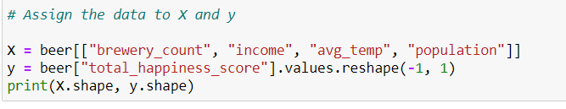
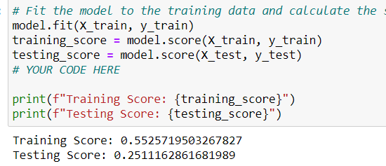
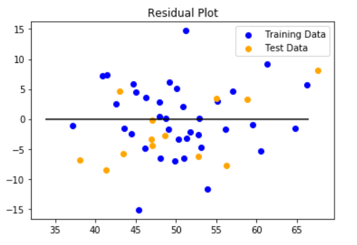
Machine Learning
Using the Machine Learning that we learned in class, we attempted to apply the same methodology and linear regression tools to get our own R-squared value.

Slide 8
Machine Learning
Tests against Total Happiness Score
Columns:
"population", "income", "total_breweries", "wineries", "avg_temp"
Linear Regression: R2 = .41
Polynomial Regression: R2 = -1.9
"population", "income", "total_breweries", "avg_temp"
Linear Regression: R2 = .43
Polynomial Regression: R2 = .13
"income", "total_breweries", "avg_temp"
Linear Regression: R2 = .48
Polynomial Regression: R2 = .40
"income", "total_breweries""
Linear Regression: R2 = .40
Polynomial Regression: R2 = .40
"population", "total_breweries""
Linear Regression: R2 = -.88
Polynomial Regression: R2 = -.83
Tried different column values and both linear and polynomial regression tests
NO CORRELATION BETWEEN OUR DATA VALUES AND HAPPINESS

Slide 9
TABLEAU

Slide 10
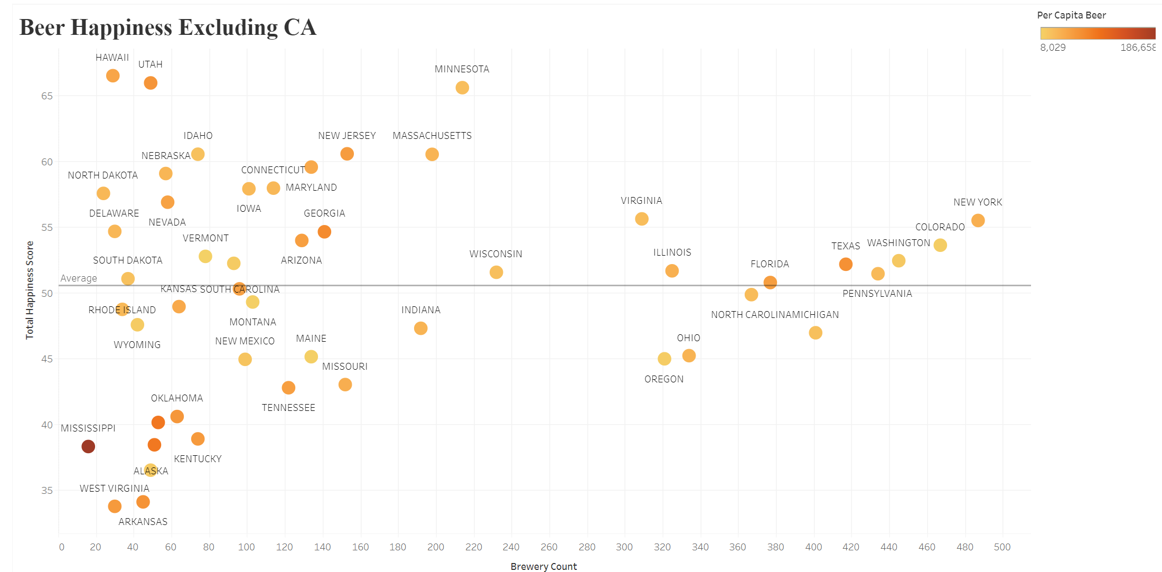
Breweries vs. Happiness Score

Slide 11
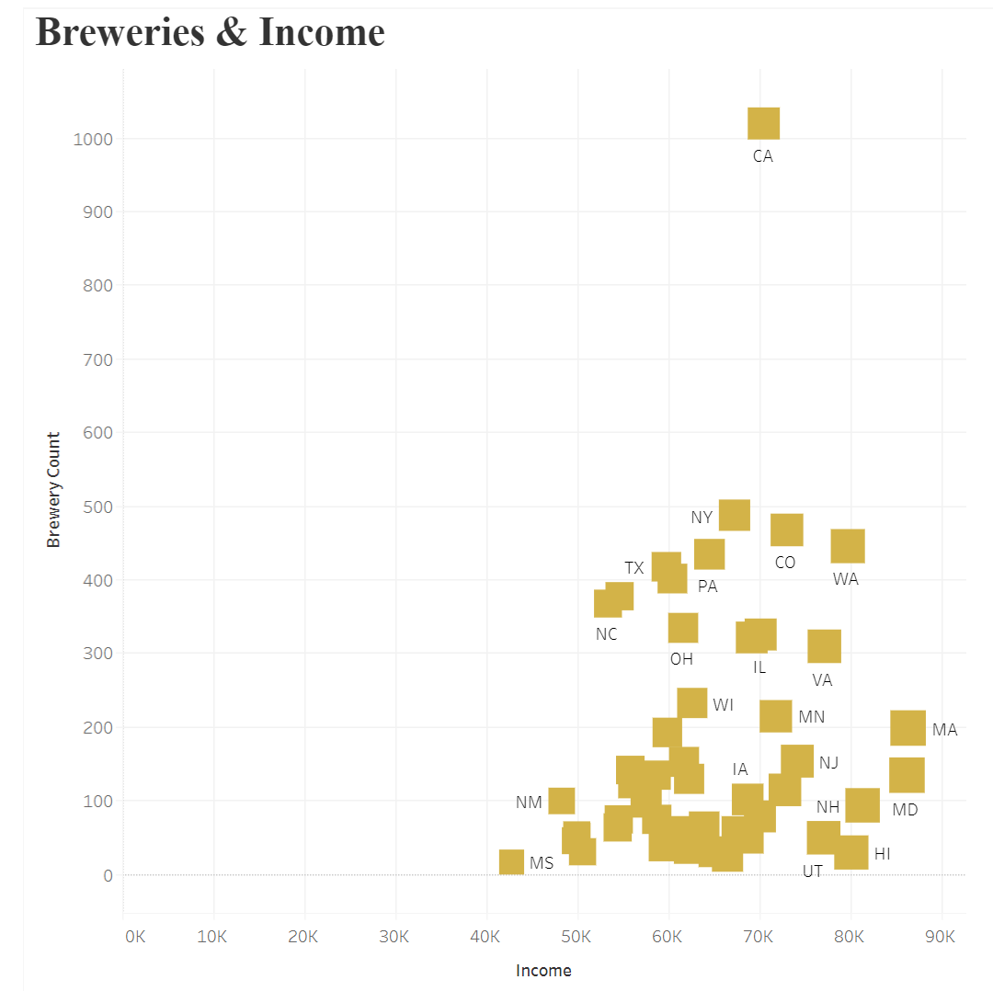
Other Factors: Income

Slide 12
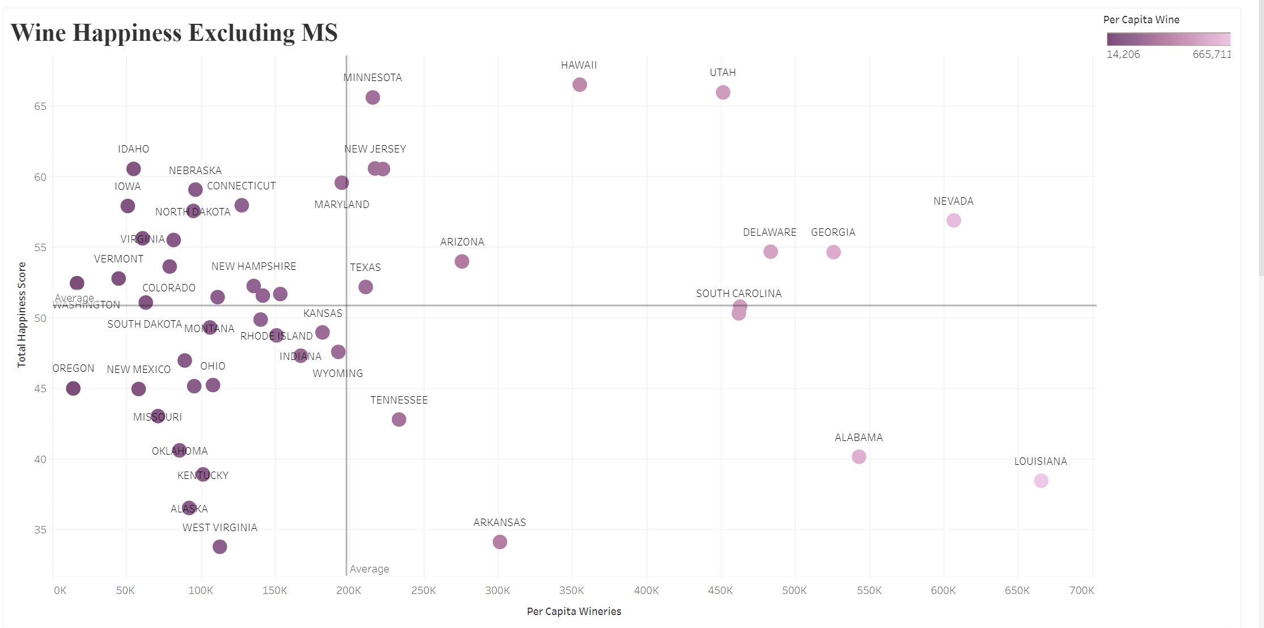
Wineries vs. Happiness Score

Slide 13
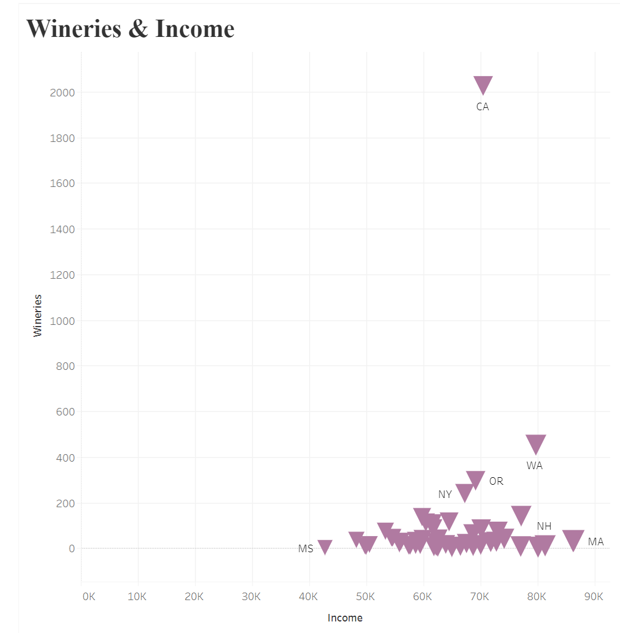
Other Factors: Income

Slide 14
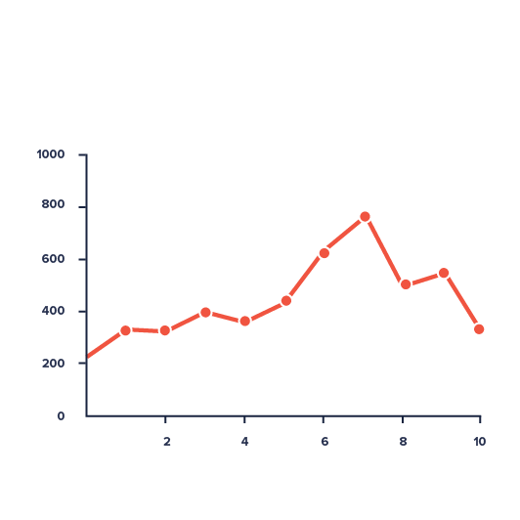

Challenges…
Understanding Machine Learning and how it can apply to our project
Understanding what the R-squared value specifically tells us in correlation with our project.

Slide 15
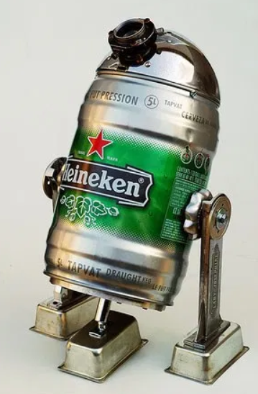


Slide 16
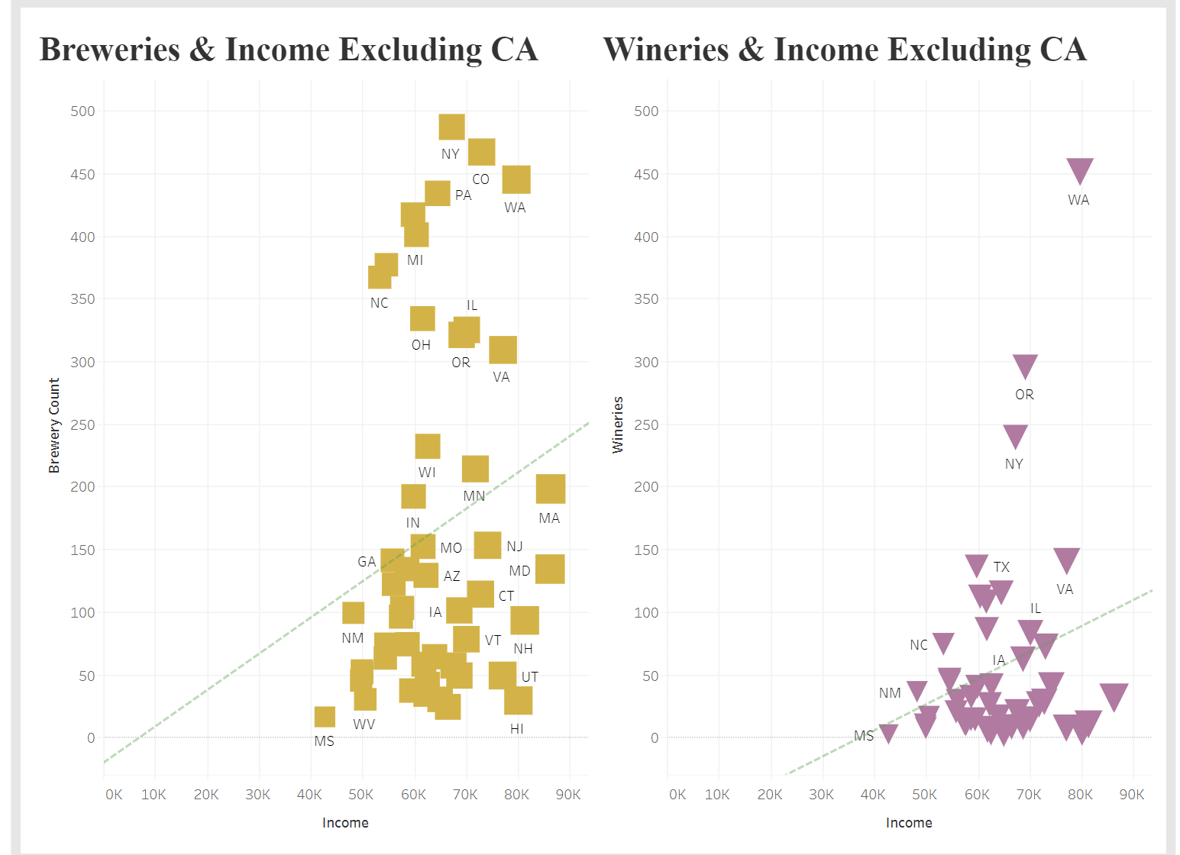
Final Conclusions
Even through machine learning and using other tools such as tableau and pandas, we were not able to come to any concrete conclusions that alcohol has any sort of effect on happiness.

Slide 17
Questions?

